Slide 1
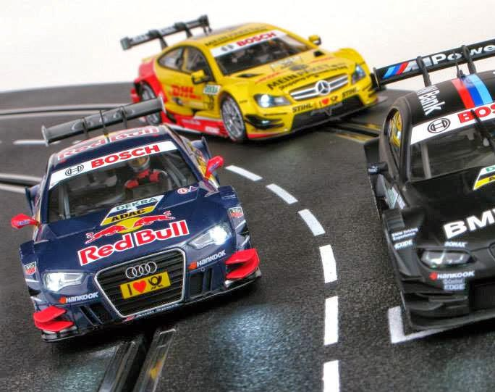
Using HTM to Perform Misbehavior Detection in Autonomous Vehicle Platoons
Ethan Swistak and Tushar Singhal

Slide 2
F2MD Framework
Cooperative Intelligent Transport System(C-ITS)
Upon entering the area of a Vehicular Ad-Hoc Network(VANET), credentials are transmitted to a Public Key Infrastructure(PKI) for verification
Vehicle will begin to transmit basic safety messages(BSM) from it’s Onboard Unit(OBU) over the VANET through various Road Side Units(RSU’s)
Misbehavior Detection(MBD)
Local vehicles assign plausibility score to each message received
An MB algorithm analyzes these features to decide if any should be reported to Misbehavior authority(MA)
MA investigates event either through human analysis or further processing. This usually involves assigning a trust score to various entities
MA will possibly file a certificate revocation request, warning, or other action if the misbehavior persists and is verified.

Slide 3
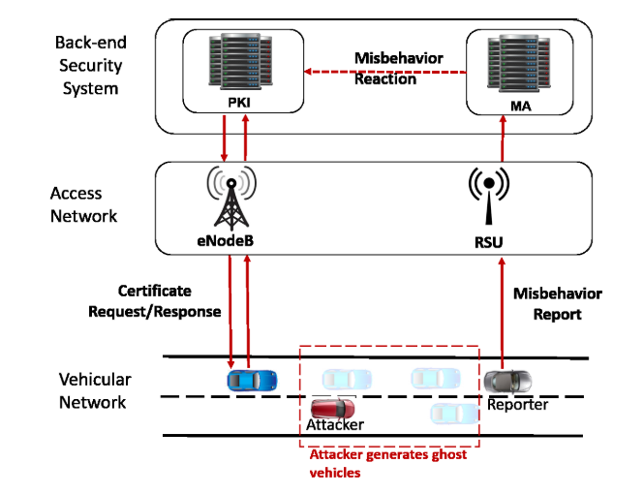

Slide 4
F2MD Framework-2
Input Dataset – GPS data for real vehicles in a given area
C-ITS network messages are simulated
Attack server simulates malfunctions and attacks
Misbehavior Detection
Basic plausibility and consistency checks
Local misbehavior detection
Misbevior authority server
Web application server

Slide 5
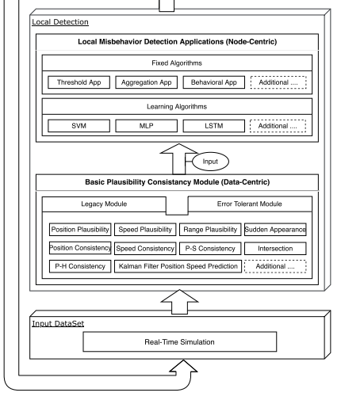
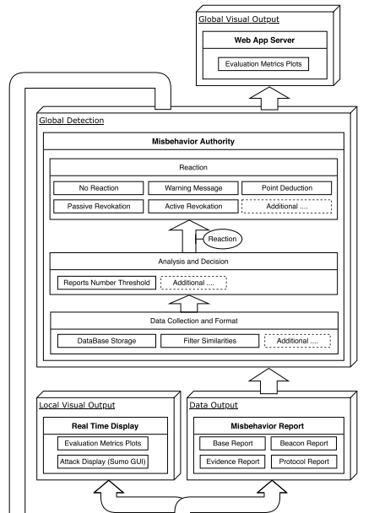

Slide 6
F2MD Framework-3
Technologies
OMNET++ is a network simulation tool, in this case used to simulate a VANET
SUMO simulates road traffic
Veins uses Omnet++ and SUMO to simulate vehicular networks
Machine learning server is mainly written in tensorflow, pascal used for real time visualization

Slide 7
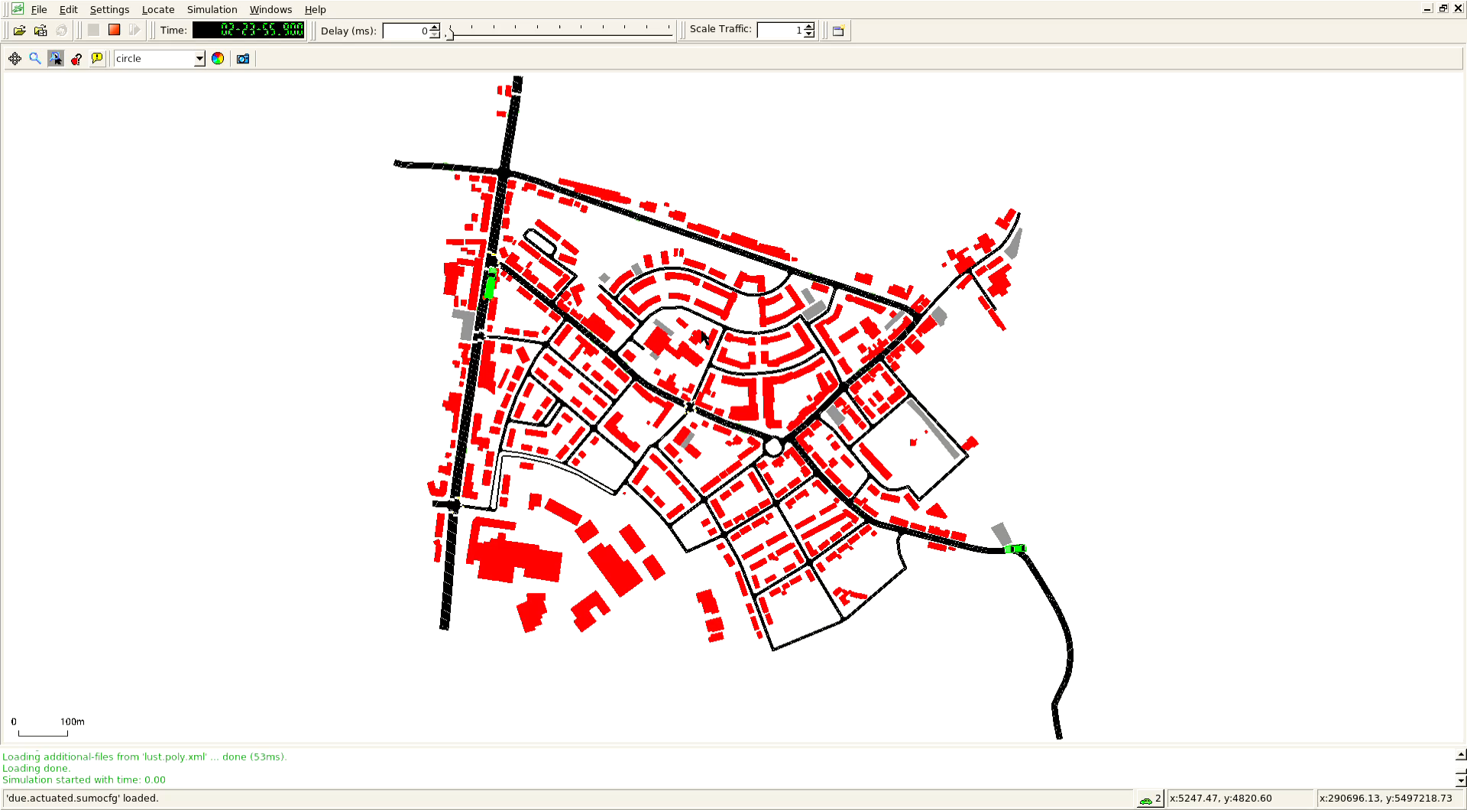

Slide 8
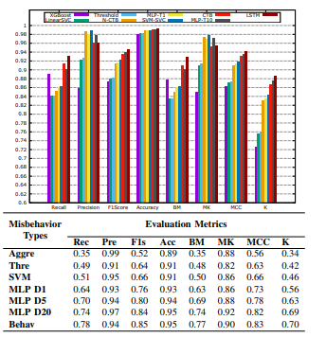

Slide 9
Challenges with F2MD
Simulation takes a long time to run, possibly days
Large Codebase means a lot of surgery is required to try out new models
Designed around tensorflow, so need to write a custom module to handle htm
Preprocessed features mean we can’t use autoencoder or similar type modeling approach(HTM)
Too many categorical variables(tiling trick?)
Potential solution: Add “tile anomaly score” to features and see if it improves performance of existing model

Slide 10
Week 3 – Progress Summary
Completed This Week | To-Do
Installed F2MD framework Reproduced results of F2MD paper Determined potential way to improve results | Train ML model using tiling strategy? Implement a 10th plausibility feature into F2MD Compare to SOTA results

